Slide 1

GLOBAL INSTITUTE OF TECHNOLOGY
Department of
Computer Science & Engineering
Subject Name with code: Data Structure & Algorithms
Unit-3
Presented by: Mr. Sohan Lal Gupta
Assistant Professor, CSE

Slide 2
GLOBAL INSTITUTE OF TECHNOLOGY JAIPUR
Data Structure & Algorithms
CSE/ III Sem
Lecture No. 3
Sohan Gupta

Slide 3
3.4.2 Insertion sort :
GLOBAL INSTITUTE OF TECHNOLOGY JAIPUR
Data Structure & Algorithms
CSE/ III Sem
Insertion sort works similarly as we sort cards in our hand in a card game.
We assume that the first card is already sorted then, we select an unsorted card. If the unsorted card is greater than the card in hand, it is placed on the right otherwise, to the left. In the same way, other unsorted cards are taken and put at their right place.
It is efficient for smaller data sets, but very inefficient for larger lists.
It is better than Selection Sort and Bubble Sort algorithms.
Its space complexity is less. Like bubble Sort, insertion sort also requires a single additional memory space.
Sohan Gupta

Slide 4
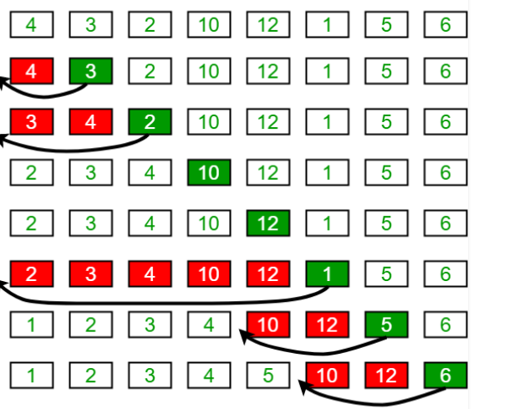
GLOBAL INSTITUTE OF TECHNOLOGY JAIPUR
Data Structure & Algorithms
CSE/ III Sem
Sohan Gupta

Slide 5
GLOBAL INSTITUTE OF TECHNOLOGY JAIPUR
Data Structure & Algorithms
CSE/ III Sem
Time Complexities of insertion sort
Worst Case Complexity: O(n2)
Best Case Complexity: O(n)
Average Case Complexity: O(n2)
Sohan Gupta

Slide 6
GLOBAL INSTITUTE OF TECHNOLOGY JAIPUR
Data Structure & Algorithms
CSE/ III Sem
Algorihms for Insertion sort
Step 1 − If it is the first element, it is already sorted. return 1;
Step 2 − Pick next element
Step 3 − Compare with all elements in the sorted sub-list
Step 4 − Shift all the elements in the sorted sub-list that is greater than the
value to be sorted
Step 5 − Insert the value
Step 6 − Repeat until list is sorted
Sohan Gupta

Slide 7
GLOBAL INSTITUTE OF TECHNOLOGY JAIPUR
Data Structure & Algorithms
CSE/ III Sem
3.4.3 Selection sort:
Selection sort is an algorithm that selects the smallest element from an unsorted list
in each iteration and places that element at the beginning of the unsorted list.
This algorithm will first find the smallest element in the array and swap it with the element in the first position,
then it will find the second smallest element and swap it with the element in the second position.
and it will keep on doing this until the entire array is sorted.
It is called selection sort because it repeatedly selects the next-smallest element and swaps it into the right place.
Sohan Gupta

Slide 8
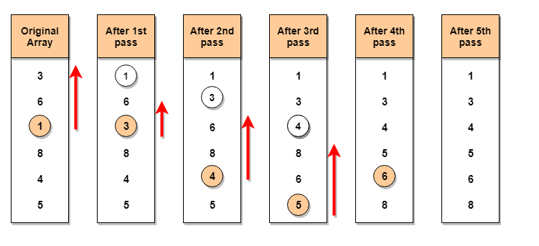
GLOBAL INSTITUTE OF TECHNOLOGY JAIPUR
Data Structure & Algorithms
CSE/ III Sem
Example: Let's consider an array with values {3, 6, 1, 8, 4, 5}
In the first pass, the smallest element will be 1, so it will be placed at the first position.
Then leaving the first element, next smallest element will be searched, from the remaining elements. We will get 3 as the smallest, so it will be then placed at the second position.
Then leaving 1 and 3(because they are at the correct position), we will search for the next smallest element from the rest of the elements and put it at third position and keep doing this until array is sorted.
Sohan Gupta

Slide 9
GLOBAL INSTITUTE OF TECHNOLOGY JAIPUR
Data Structure & Algorithms
CSE/ III Sem
Time Complexities:
Worst Case Complexity: O(n2) If we want to sort in ascending order and the array is in descending order then, the worst case occurs.
Best Case Complexity: O(n2) It occurs when the array is already sorted
Average Case Complexity: O(n2) It occurs when the elements of the array are in jumbled order (neither ascending nor descending).
Sohan Gupta

Slide 10
GLOBAL INSTITUTE OF TECHNOLOGY JAIPUR
Data Structure & Algorithms
CSE/ III Sem
Algorithm for Selection Sort:
Step 1 − Set min to the first location
Step 2 − Search the minimum element in the array
Step 3 – swap the first location with the minimum value in the array
Step 4 – assign the second element as min.
Step 5 − Repeat the process until we get a sorted array.
Sohan Gupta

Slide 11
GLOBAL INSTITUTE OF TECHNOLOGY JAIPUR
Data Structure & Algorithms
CSE/ III Sem
Thank You… .
Any Quries ?
Sohan Gupta

